Slide 1

VIT BHOPAL UNIVERSITY
SCHOOL OF COMPUTER SCIENCE AND ENGINEERING

Slide 2

Digital Portfolio
Ashesh Cholkar
18BCE10065
B. Tech.
Computer Science and Engineering

Slide 3
About Me
I am Ashesh Cholkar, currently pursuing my Bachelor's degree in Computer Science and Engineering from VIT Bhopal University and expected to graduate in May 2022.
My interests lie in the fields of Front End Web Development, Embedded Systems, 3D Modeling, Neural Networks.
I have worked as a Summer Intern in Microsoft AEP Verzeo and got trained in Full Stack Web Development.
I got placed in Robert Bosch and my Internship will be commencing from January 2022.

Slide 4





Technical Skills
HTML/CSS/JS
JAVA
C++
ADOBE PHOTOSHOP
BLENDER
75%
80%
70%
60%
50%

Slide 5



PROJECTS

Slide 6


Lighthouse API
Lighthouse is an idea that can ease the life of visually impaired people in the modern scenario.
The primary objective of our project Lighthouse was to design an entirely new mechanism that allows system to differentiate between humans and machines but in such a way that it also provides a feasible solution for the visually impaired community.
It also deals with all security aspects of CAPTCHA validation and capable of providing a mechanism which is user friendly for the people with visual imparities or people who have low vision power.
Technologies used were HTML/CSS, JavaScript, Python, MySQL

Slide 7
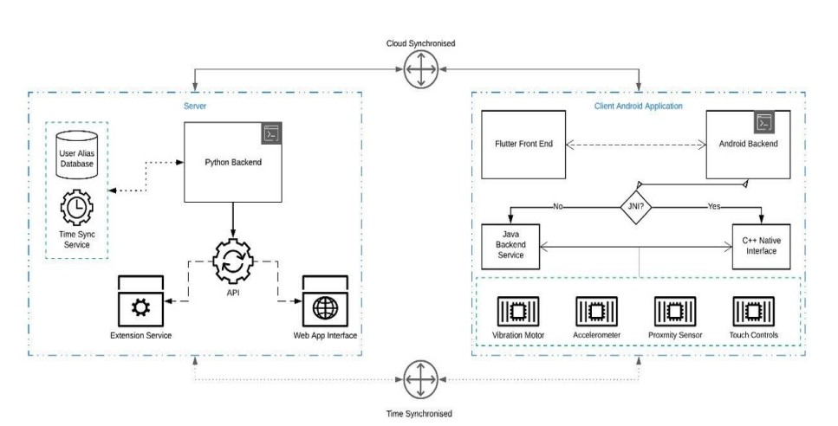

Slide 8
Fashion-MNIST using ConvNet
Deep learning algorithm- Convolutional Neural Network was applied on Fashion- MNIST dataset for image classification and to predict the labels of images.
A Convolutional Neural Network (ConvNet/CNN) is a Deep Learning algorithm which can take in an input image, assign importance (learnable weights and biases) to various aspects/objects in the image and be able to differentiate one from the other.
Labels of images like T-Shirts, Shoes, Jeans, etc. were predicted using CNN keras as to give better search results in e-commerce websites.
Technologies used were R Programming language, RStudio

Slide 9
Automatic Room Light Controller with Bidirectional Visitor Counter
A microcontroller based light controller system is designed to help in saving electricity. The system counts the number of visitors entering a room and switches ON or OFF the lights accordingly. The total number of persons inside the room is also displayed on the LCD display.
An embedded system is nothing but a computer system which is designed to perform many operations. These include accessing the data, process the data, store the data and also control the data in electronics based systems.
Digital Visitor Counter can be used in various rooms like seminar or conference halls, movie theaters where the capacity of the room is limited and should not be exceeded especially in these times of pandemic.
Technologies used were: C Programming Language, Arduino UNO

Slide 10
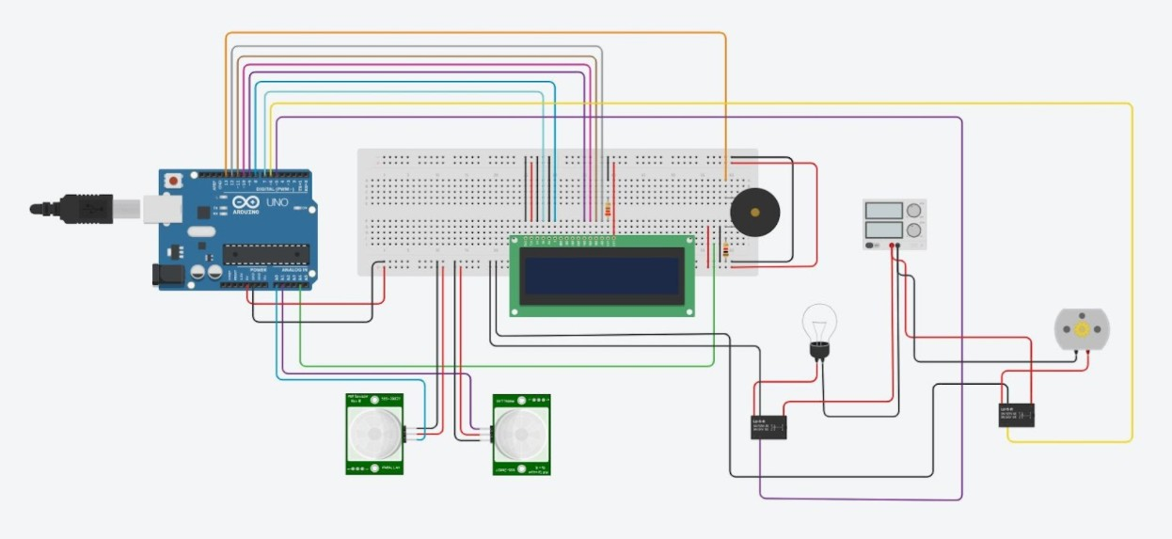

Slide 11


INTERNSHIP

Slide 12

Microsoft AEP Verzeo
Summer Intern at Verzeo (affiliated with IIT Bombay). Got Training in Full Stack Web Development along with a hands-on project on Interior Designing website.

Slide 13


Slide 14


CERTIFICATIONS

Slide 15
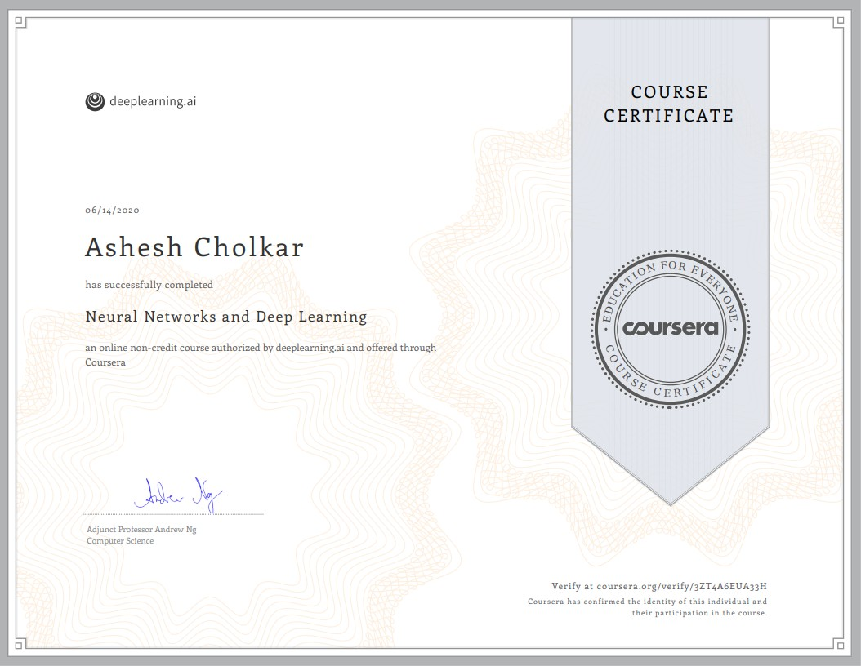
Neural Networks and Deep Learning

Slide 16
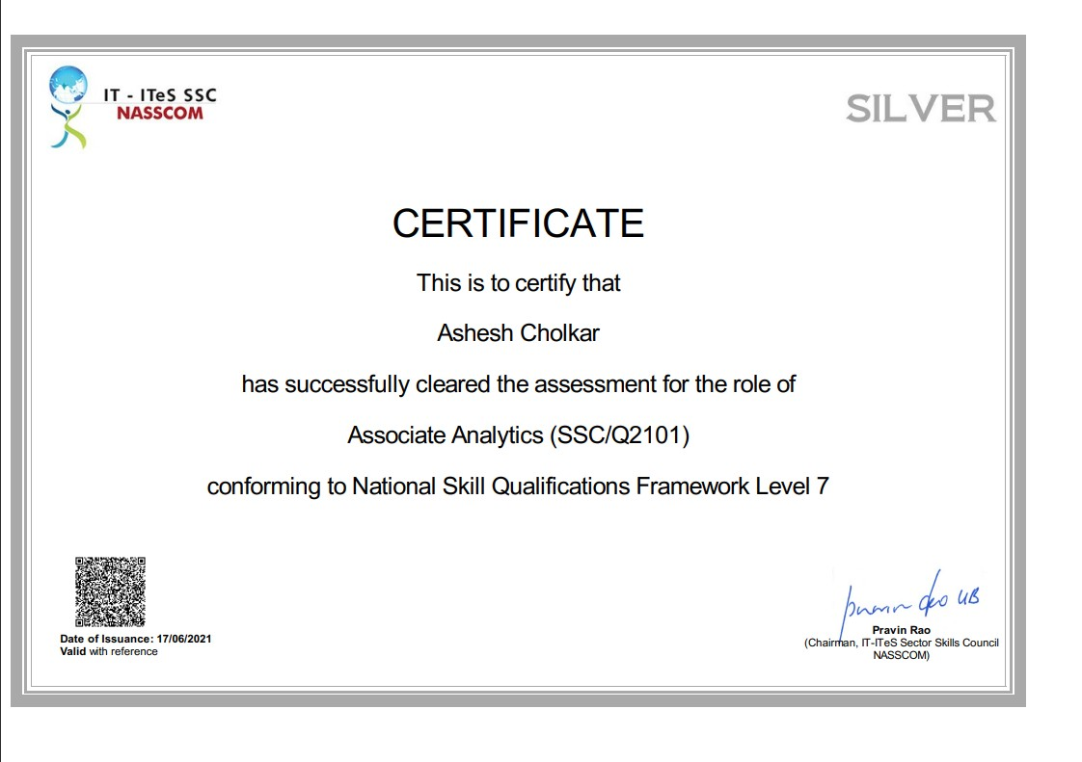
Associate Analytics - NASSCOM

Slide 17

Full Stack Web Development

Slide 18

WORKSHOPS

Slide 19
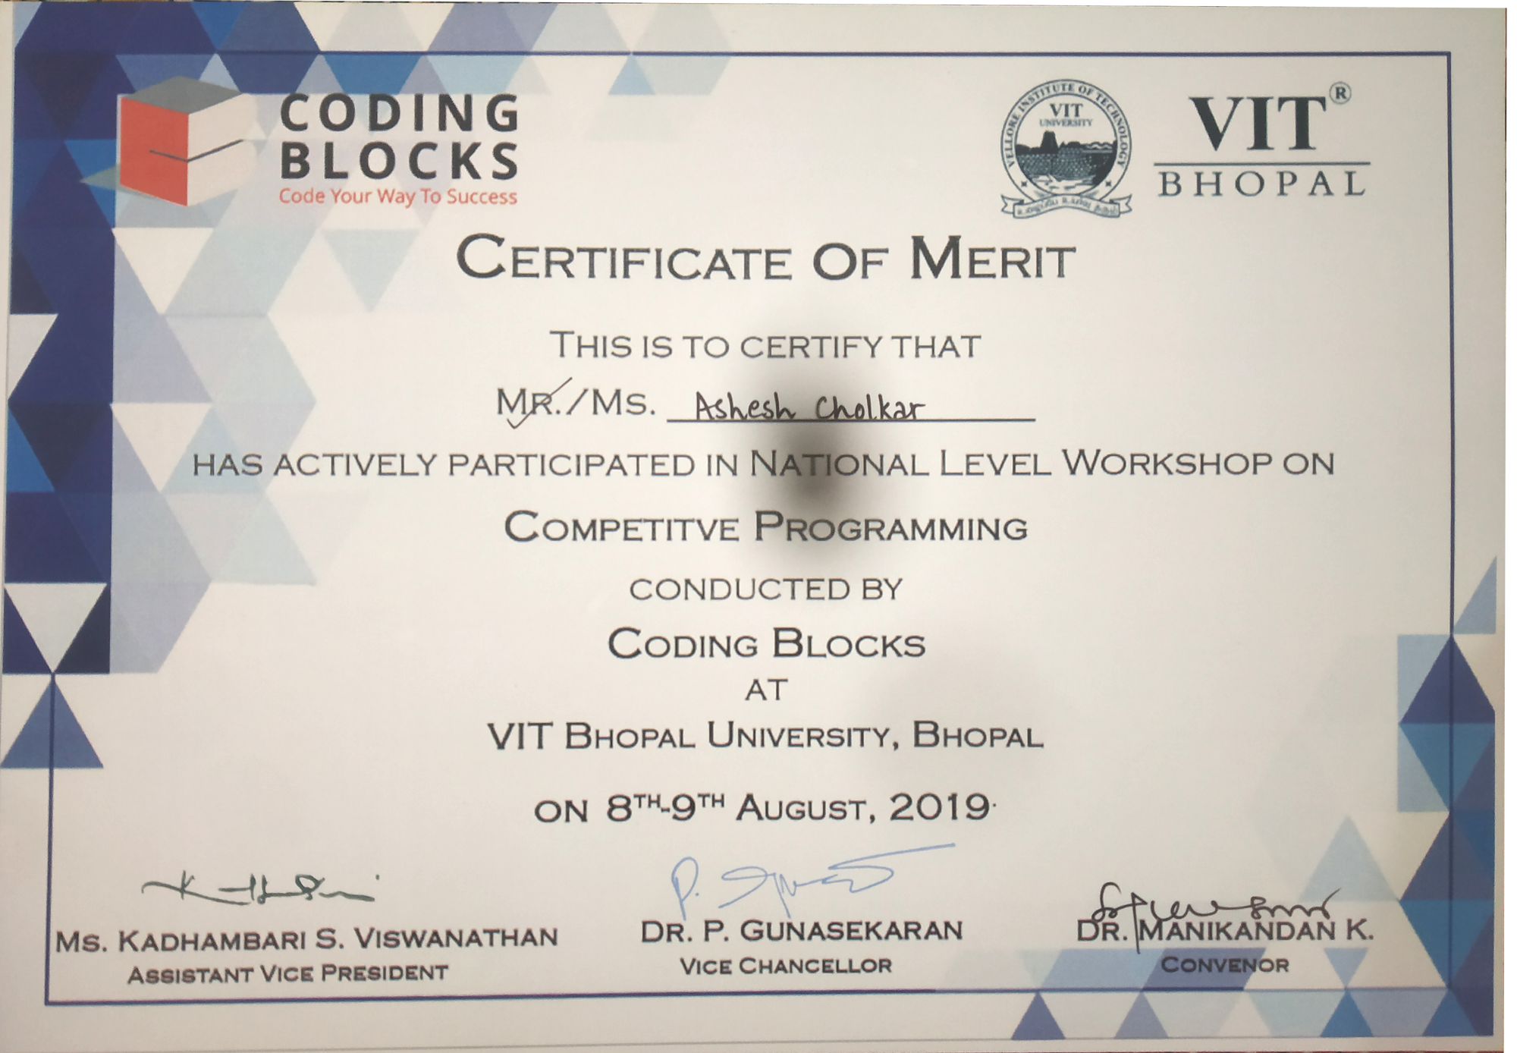

Slide 20
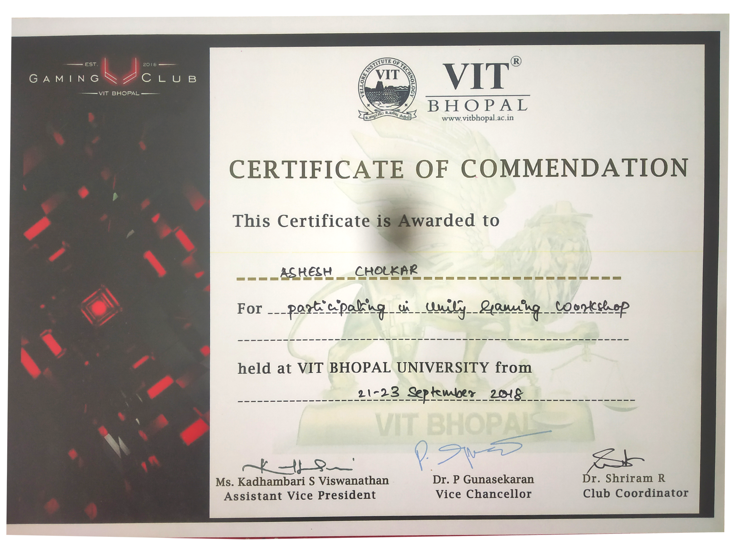

Slide 21


EXTRA CURRICULARS

Slide 22
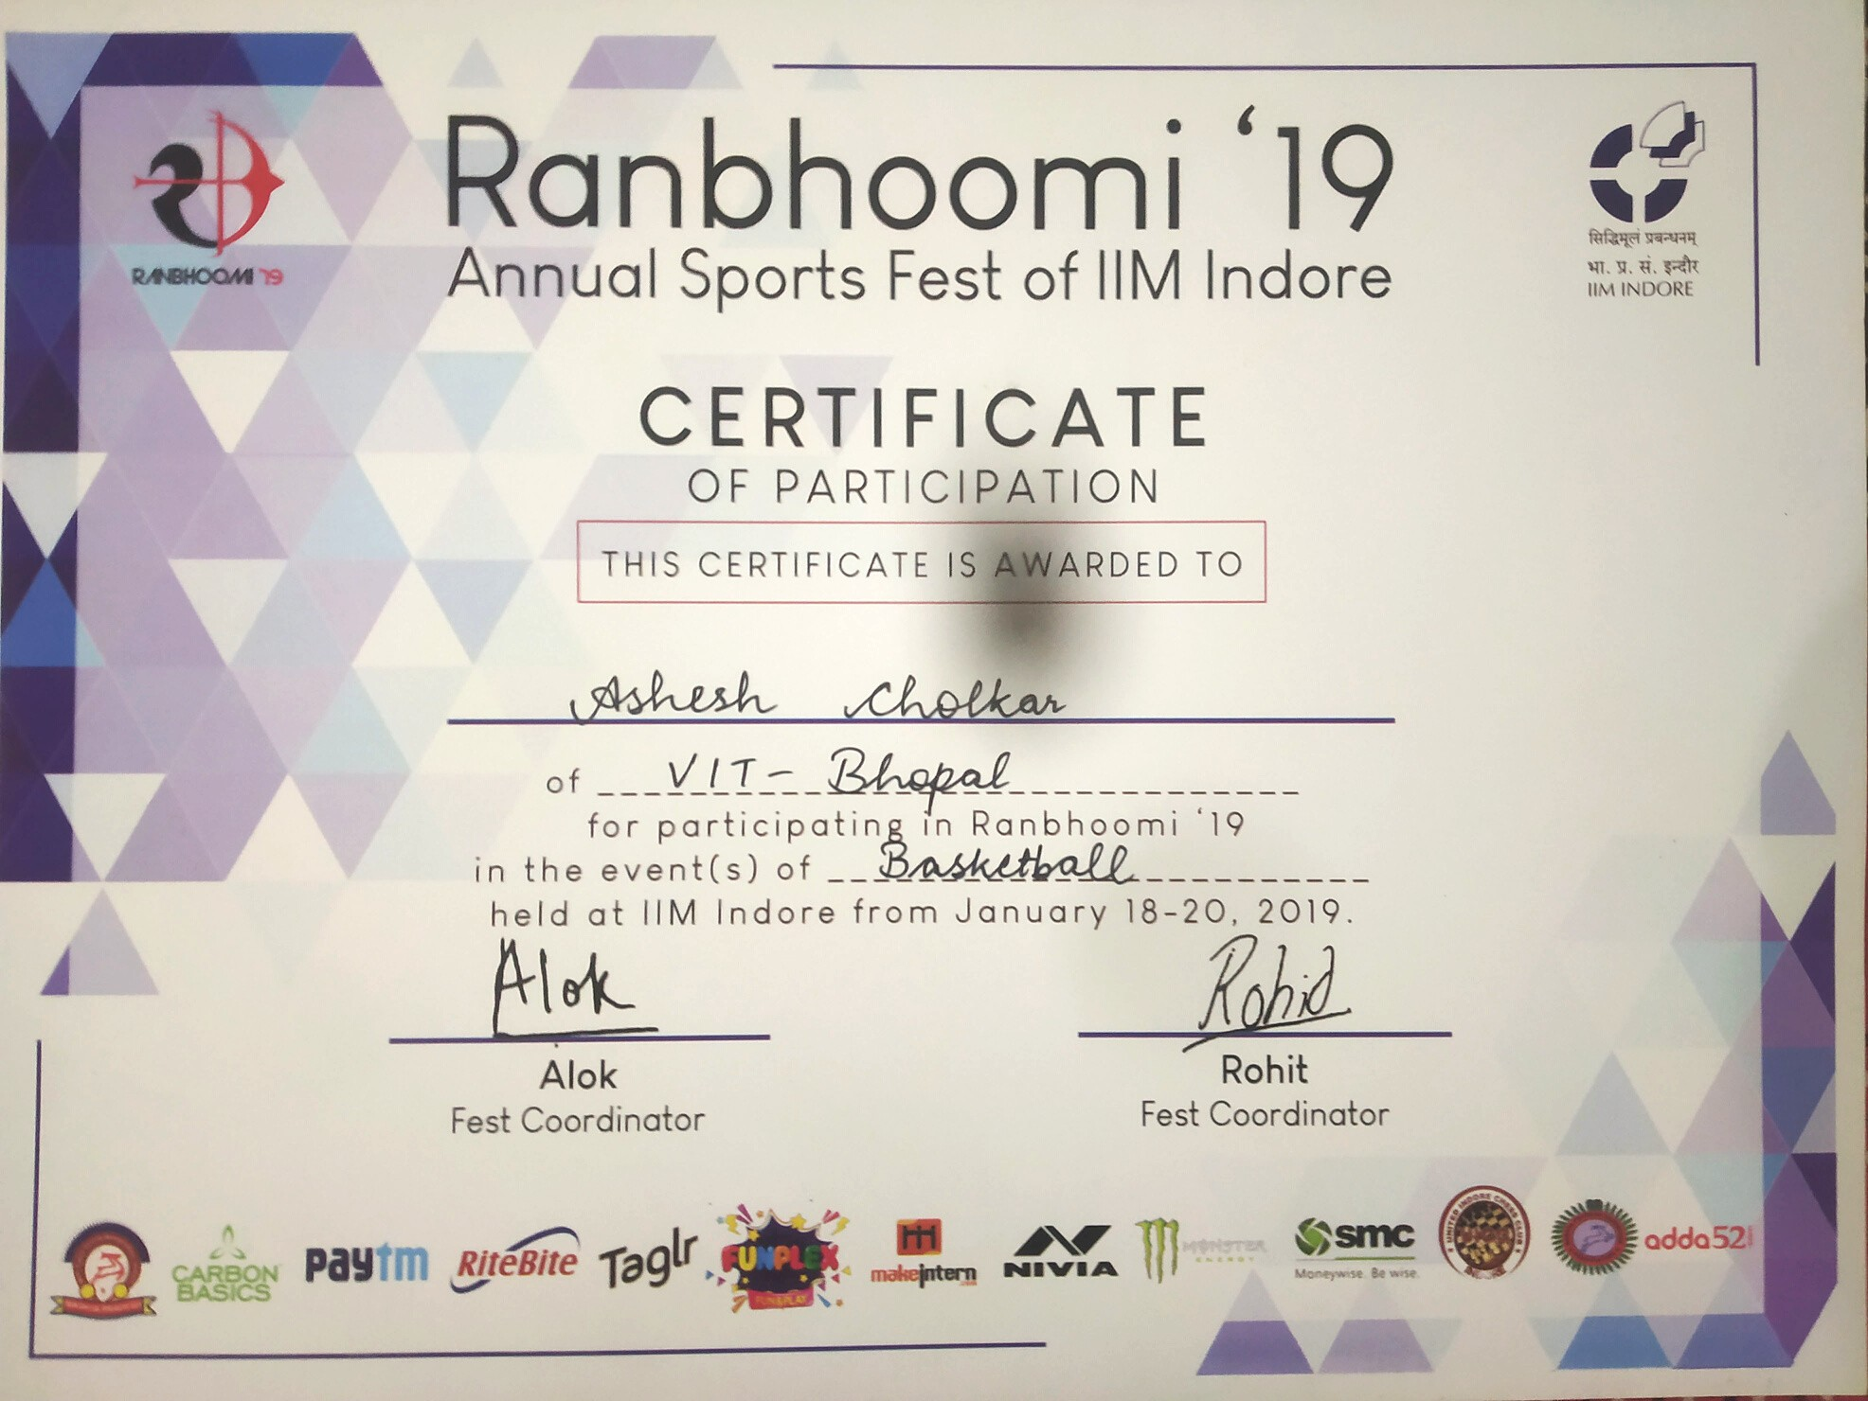

Slide 23
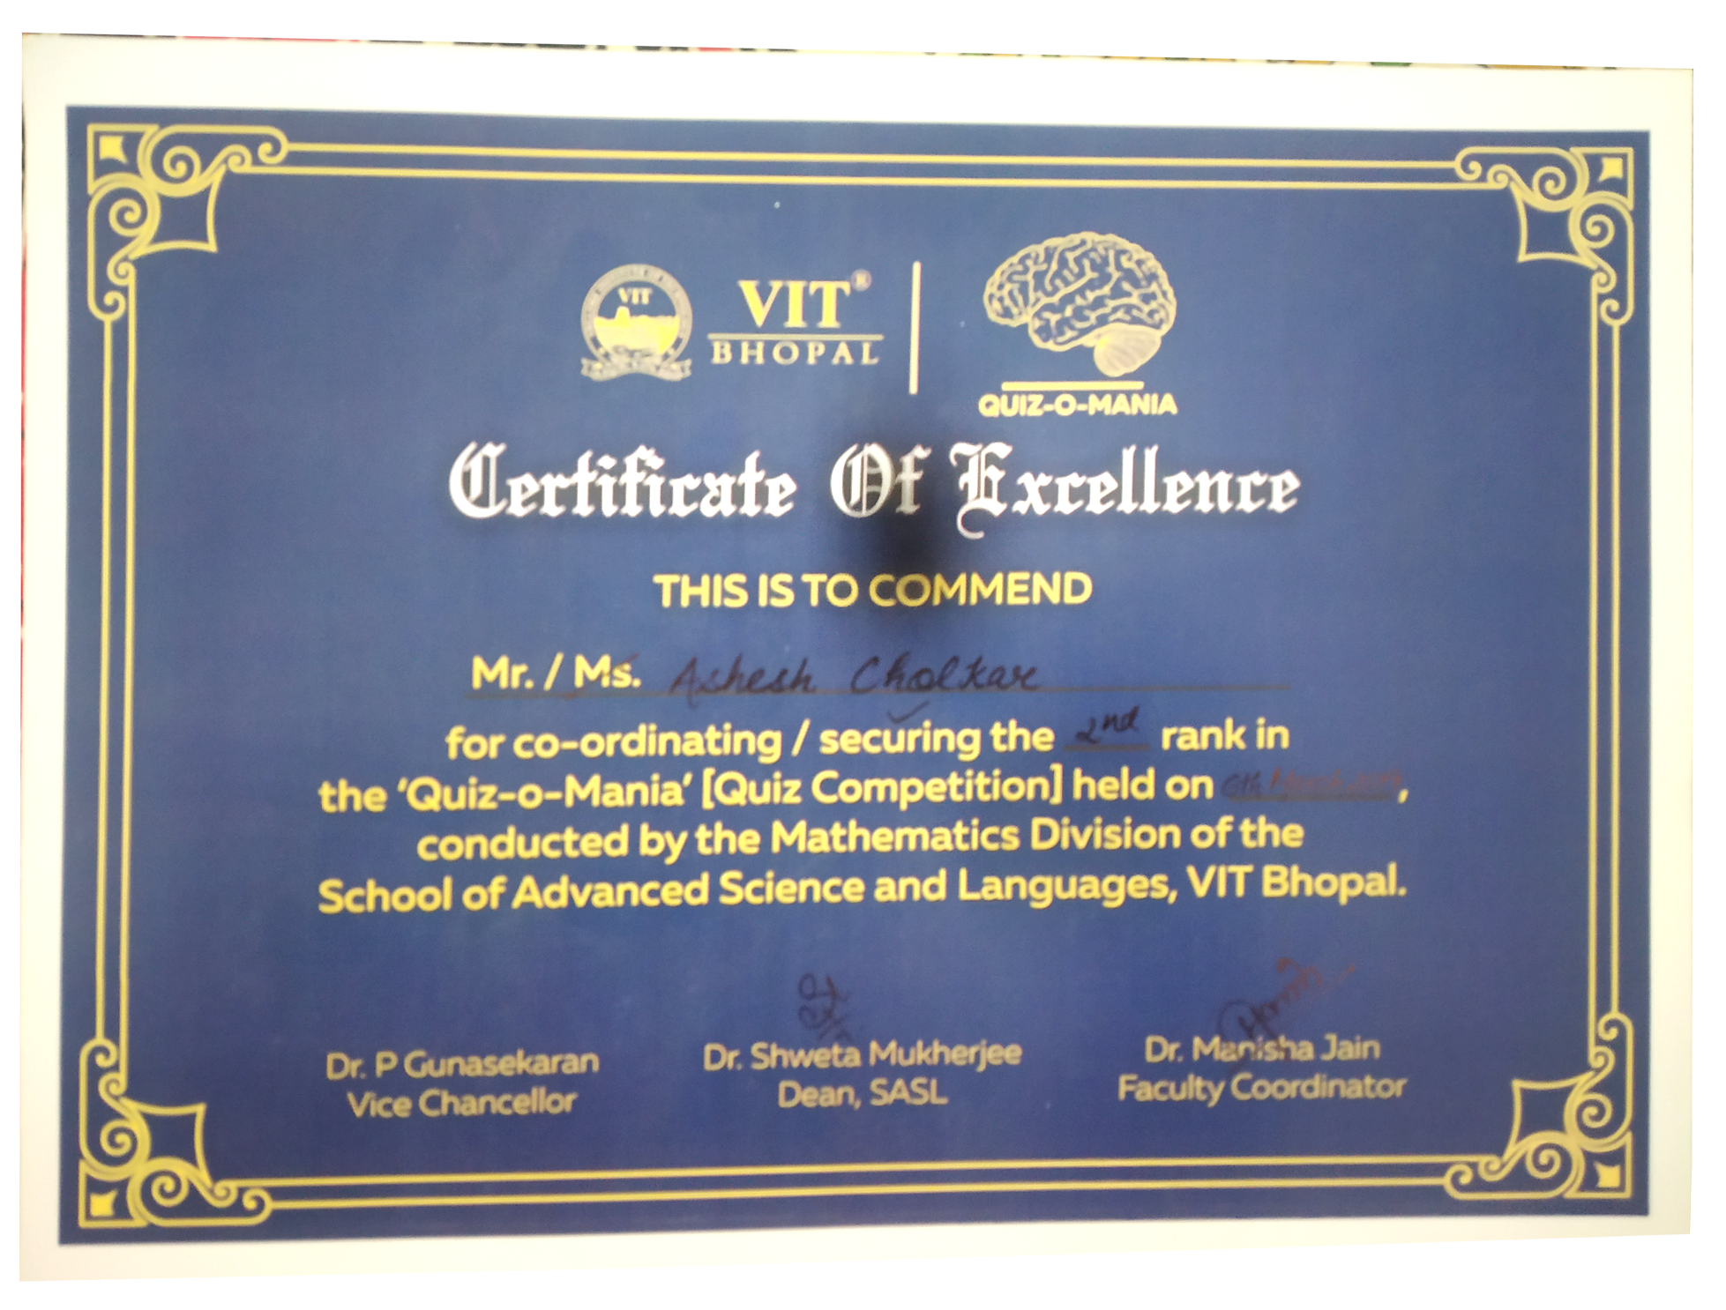

Slide 24
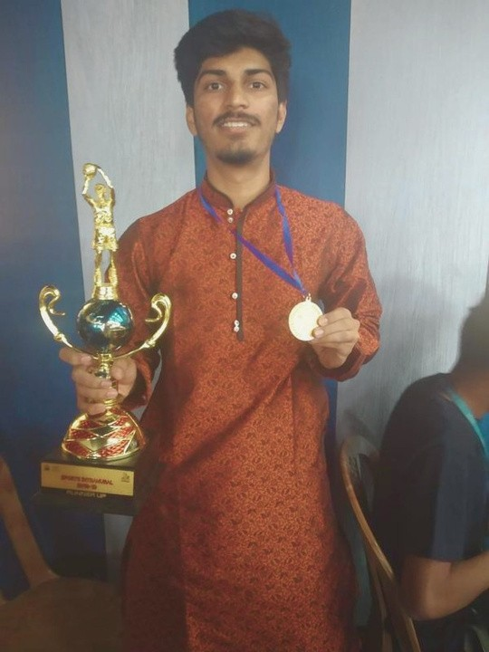

Responsibilities
Sports Club Volunteer, AdVITya, VIT Bhopal
1
2
Basketball Team
Member, VIT Bhopal
Creative and Design
Department, AdVITya, VIT Bhopal
3

Slide 25



HOBBIES
BASKETBALL
PHOTO MANIPULATION
Represented School and College teams in tournaments
Designing Abstract artworks based on space and diverse ideas
COMPETITIVE FPS GAMING
Won 1st position in AdVITya CSGO Tournament
SKETCHING
Landscapes and Portraits

Slide 26

Thank You

